Slide 1

Introduction to DL, ML, CV and ResNet-50 architecture
Surface IL

Slide 2
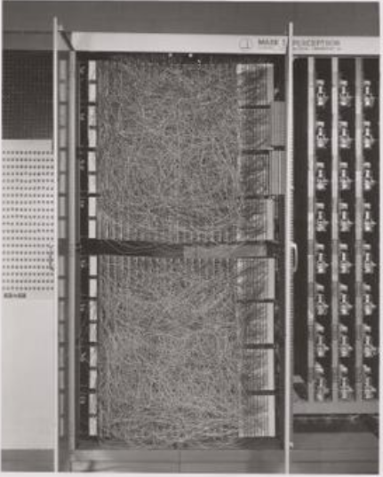
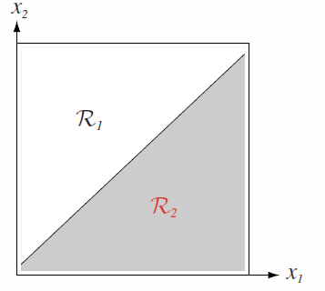
Perceptron
The Perceptron idea was firstly introduced in 1943 by Warren McCulloch and Walter Pitts
First implementation by Frank Rosenblatt in 1958
Implementation was almost 100% HW based:
Photocells (Input array)
Potentiometers (Weights)
Motors (Learning automation)
This huge machine produced only One decision (a.k.a Linear Classifier)
Mark-I Perceptron Machine

Slide 3
The XOR Test

Slide 4
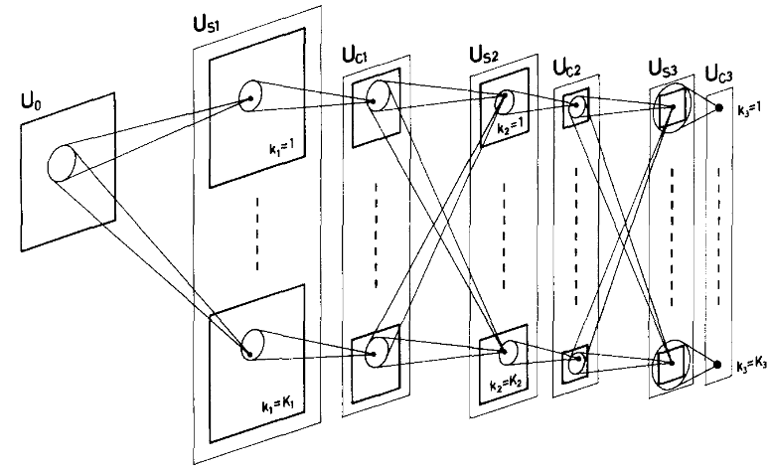
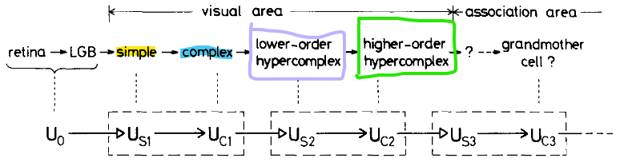
NeoCognitron
Multilayered neural network, introduced in 1980 by Kunihiko Fukushima
A computational model resembling the visual system
Built of simple (convolution) and complex (pooling) cells
No training process
Everything is built-in (hardcoded)
Resembles to the AlexNet Network (32 years)

Slide 5
Backprop

Slide 6
Agenda
Brief Introduction to ML / PR
What is AI? MV? ML? DL? ANN? DNN?
How it all started
ANN Model Classes
CNNs
Parameters
Arithmetic
DNN Building Blocks
ResNet-50 + Demo
If Time Permits:
Training Process
Transfer Learning + Demo

Slide 7
Buzzwords
Artificial Intelligence
AI
Pattern Recognition
PR
ML
Machine Learning
Artificial Neural Networks
ANN
DL
Deep Learning

Slide 8
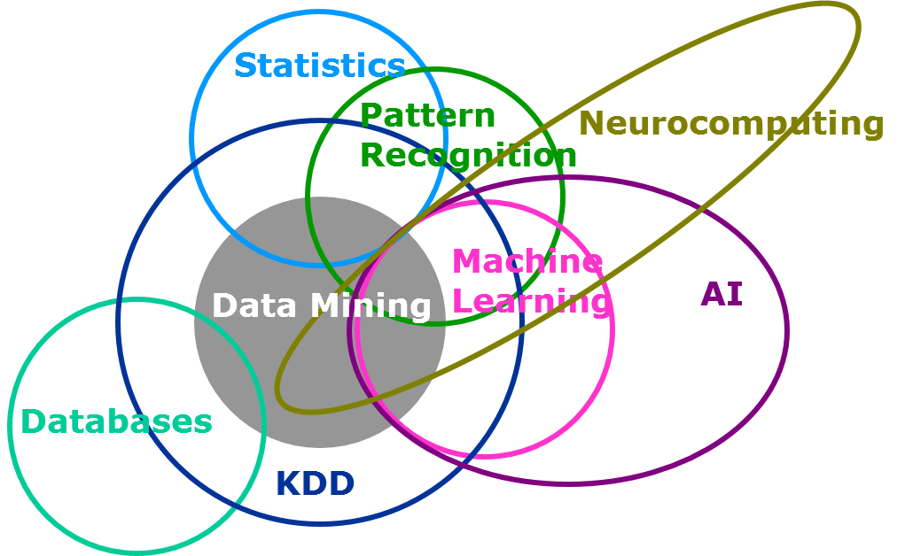
Buzzwords

Slide 9
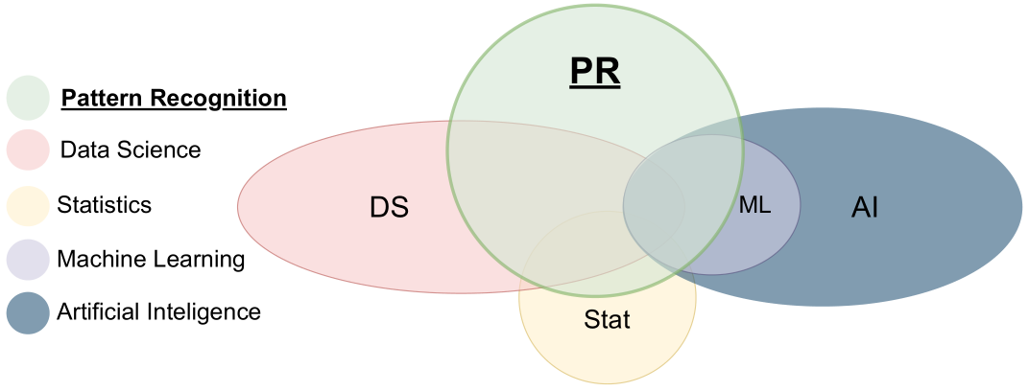
Brief Introduction to ML / PR

Slide 10
Taxonomy of Pattern Recognition Methods
Detection, Identification, and Classification Algorithms
Physical Models
Cognitive Rule Based Models
Feature Based Inference Techniques
Simulation
Estimation
Kalman Filtering
Least Squares
Maximum Likelihood
Syntactic
Image Algebra
Expert Systems
Logical Templates
Knowledge Based
Systems (Graphs)
Fuzzy Set Theory
Supervised
Parametric
Classical Inference
Bayesian
Dempster-Schafer
Non-Parametric
Templates
Neural Networks
Support Vector Machines
Genetic Algorithms
Unsupervised
Clustering
Voting Methods Figures of Merit
Correlation
Thresholding Logic

Slide 11
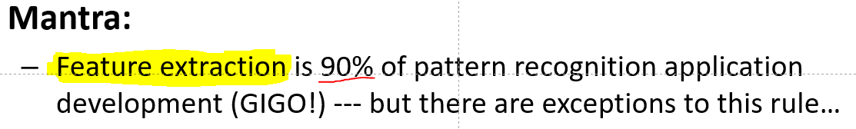
Taxonomy of Pattern Recognition Methods
Detection, Identification, and Classification Algorithms
Physical Models
Cognitive Rule Based Models
Feature Based Inference Techniques
Simulation
Estimation
Kalman Filtering
Least Squares
Maximum Likelihood
Syntactic
Image Algebra
Expert Systems
Logical Templates
Knowledge Based
Systems (Graphs)
Fuzzy Set Theory
Supervised
Parametric
Classical Inference
Bayesian
Dempster-Schafer
Non-Parametric
Templates
Neural Networks
Support Vector Machines
Genetic Algorithms
Unsupervised
Clustering
Voting Methods Figures of Merit
Correlation
Thresholding Logic

Slide 12
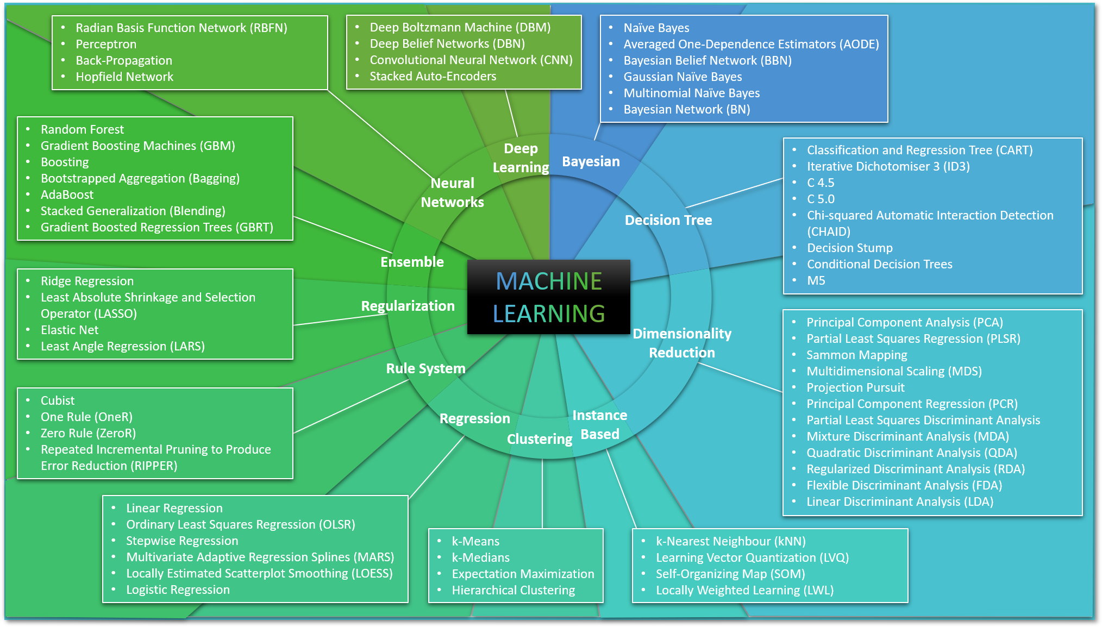
How it all started?

Slide 13
How it all started?

Slide 14
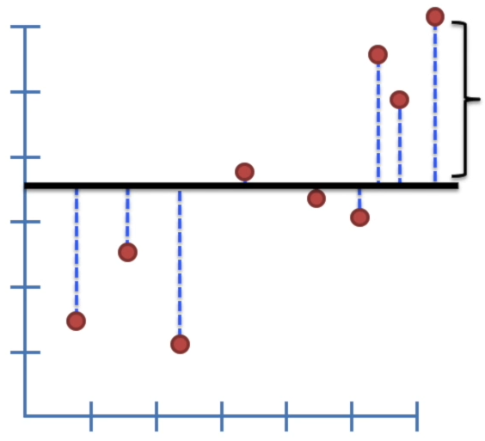
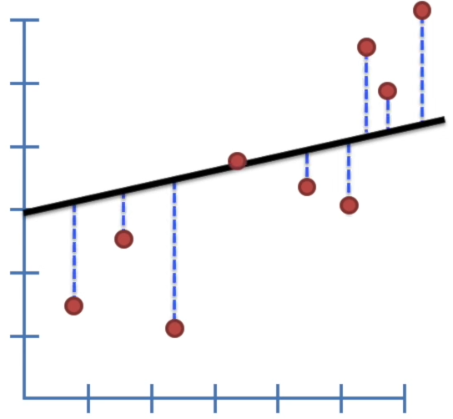
Linear Regression
Fitting a linear line to a data
Starting with arbitrary line
Calculating the sum of squares error
Rotating the line (step-size)
Choose the line with the MSSE (minimum sum of squares error)

Slide 15
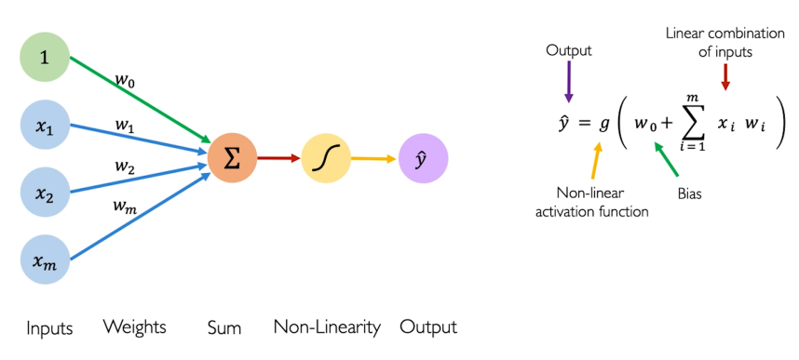
(Modern) Perceptron
Capable of forming a linear decision boundary (hyperplane)

Slide 16
The AND problem
x₁
x₂
output
x₂
0 | 0 | 0
0 | 1 | 0
1 | 0 | 0
1 | 1 | 1
(0,1)
(1,1)
x₁
(0,0)
(1,0)

Slide 17
The OR problem
x₁
x₂
output
x₂
0 | 0 | 0
0 | 1 | 1
1 | 0 | 1
1 | 1 | 1
(0,1)
(1,1)
x₁
(0,0)
(1,0)

Slide 18
The XOR problem
x₁
x₂
output
x₂
1
-1 | -1 | 1
-1 | 1 | -1
1 | -1 | -1
1 | 1 | 1
x₁
-1
1
-1

Slide 19
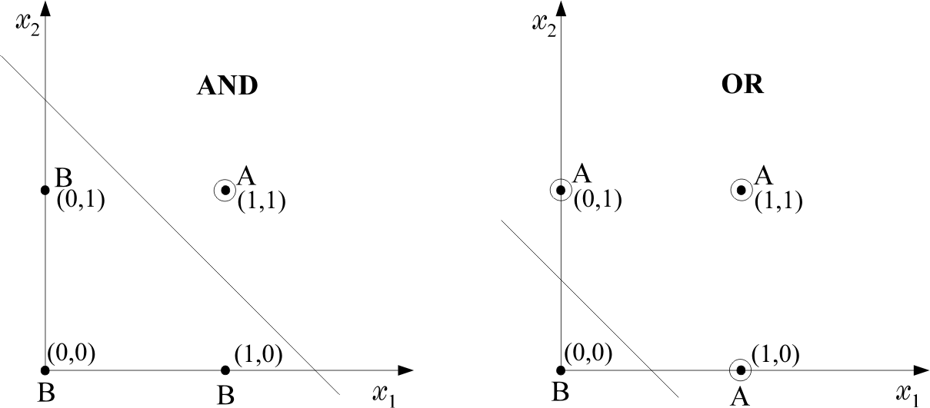
The XOR problem - Solution

Slide 20
The XOR problem - Solution
Let’s combine them-> 2 Perceptrons!

Slide 21
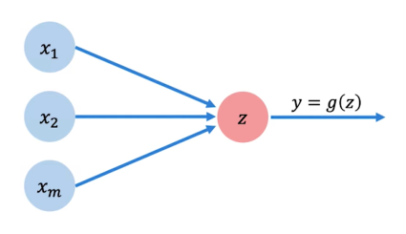
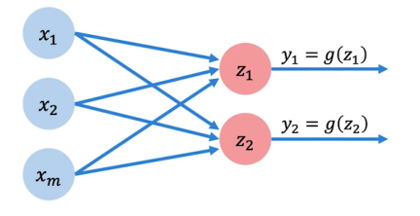
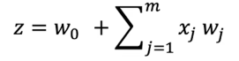
The XOR problem - Solution

Slide 22
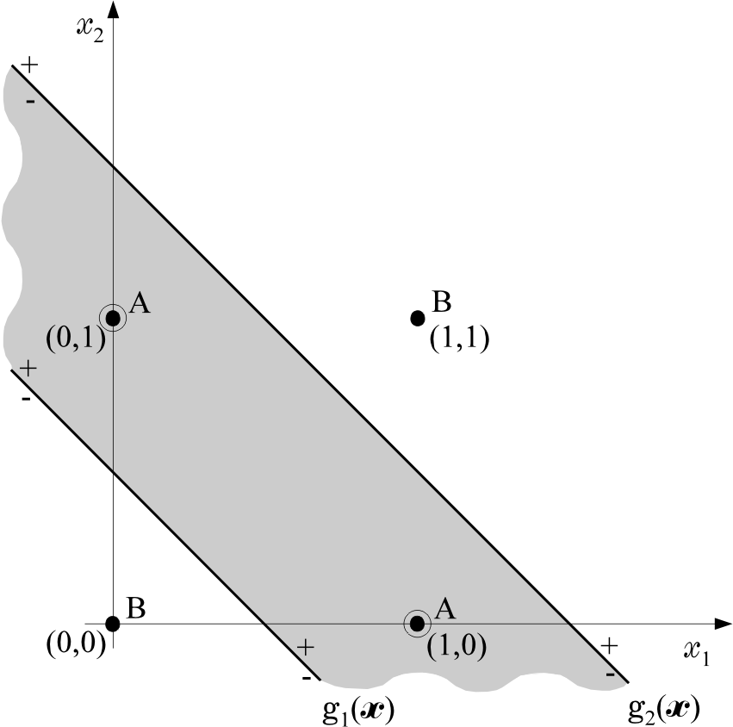
The XOR problem - Solution
g₁ < 0 and g₂ > 0: class 1
g₁ > 0 and g₂ < 0: class 1

Slide 23
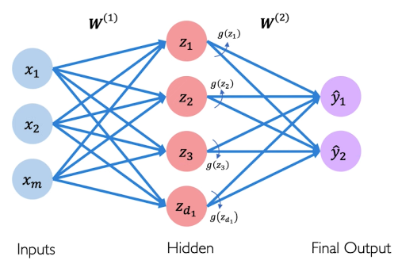
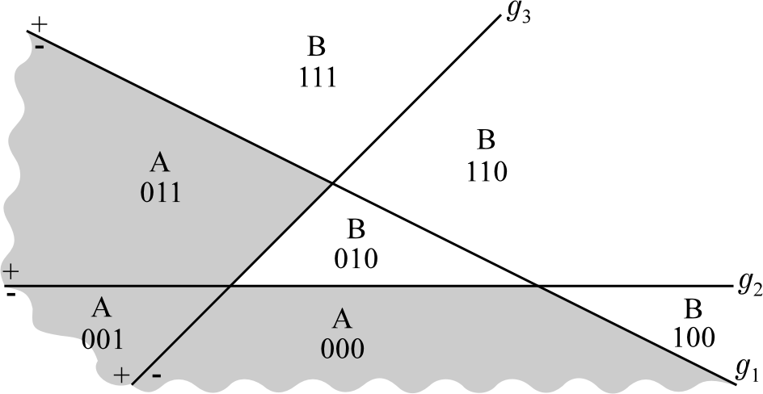
Multi-layer perceptron (ANN)

Slide 24
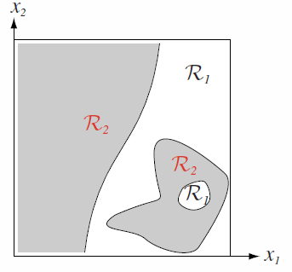
Multi-layer perceptron (ANN)
Is that possible?!
Lines are not linear

Slide 25
ANN Model Classes
CNN (Convolutional Neural Networks)
RNN (Recurrent Neural Networks)
GAN (Generative Adversarial Networks)
LSTM (Long-Short Term Memory)
Transformers
Transducers
And many(many) more…

Slide 26
ANN Model Classes
CNN (Convolutional Neural Networks)
RNN (Recurrent Neural Networks)
GAN (Generative Adversarial Networks)
LSTM (Long-Short Term Memory)
Transformers
Transducers
And many(many) more…

Slide 27
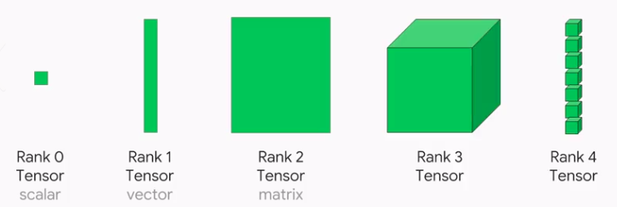
CNN Layer
Parameters:
Stride
Padding
Dilation
Tensor Format:
[N,Ci​,Hi​,Wi​] – 4D Tensor
Output Format:
[N,Co​,Ho​,Wo] – 4D Tensor
Notes:
Use Matlab to demonstrate the different ResNet50 Building blocks and layers + Parameters

Slide 28
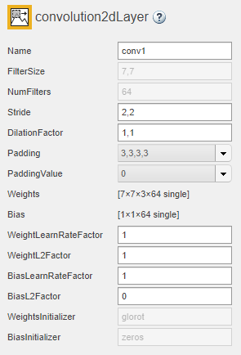
CNN Layer
Parameters:
Stride
Padding
Dilation
Tensor Format:
[N,Ci​,Hi​,Wi​] – 4D Tensor
Output Format:
[N,Co​,Ho​,Wo] – 4D Tensor
Notes:
Use Matlab to demonstrate the different ResNet50 Building blocks and layers + Parameters

Slide 29
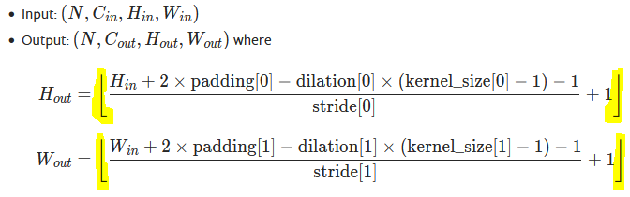
CNN Layer
Parameters:
Stride
Padding
Dilation
Tensor Format:
[Ni,Ci​,Hi​,Wi​] – 4D Tensor
Tensor Format:
N - Batch Size (Most of the time=1)
C - Number Of Channels
H - Kernel Height
W - Kernel Width
Output Format:
[No,Co​,Ho​,Wo] – 4D Tensor

Slide 30
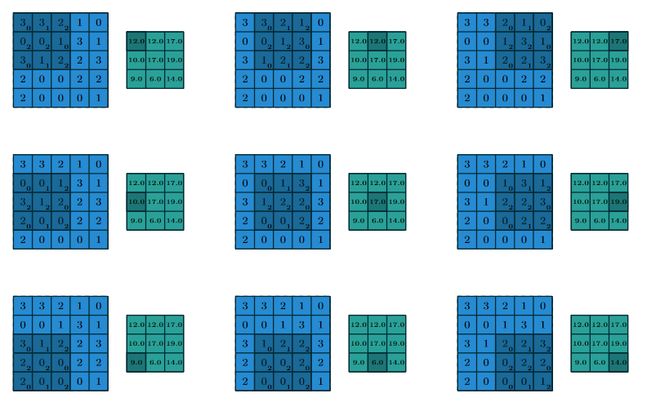
CNN Arithmetic
Notes:
Show Animations

Slide 31

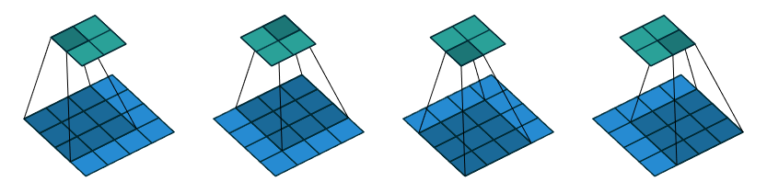
CNN Arithmetic
Parameters:
No Padding
Unit stride
Unit Dilation
S=1, p=0, d=1
Notes:
Show Animations

Slide 32

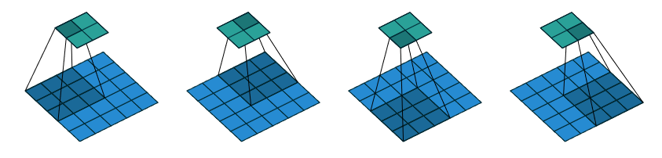
CNN Arithmetic
Parameters:
No Padding
stride
Unit Dilation
S=[2, 2], p=0, d=1
Notes:
Show Animations

Slide 33

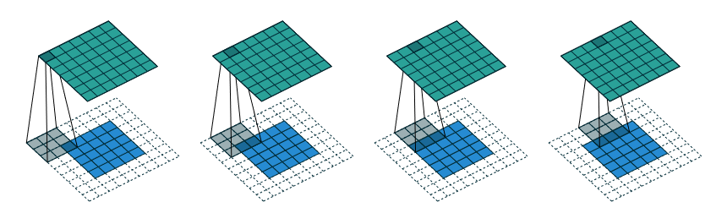
CNN Arithmetic
Parameters:
Padding
stride
Unit Dilation
S=1, p=[2, 2, 2, 2], d=1
Notes:
Show Animations

Slide 34

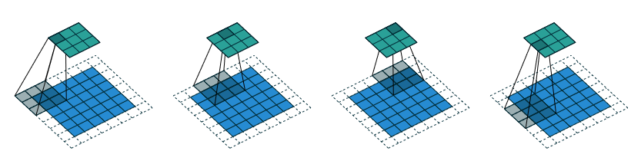
CNN Arithmetic
Parameters:
Padding
stride
Unit Dilation
S=[2, 2], p=[1, 1, 1, 1], d=1
Notes:
Show Animations

Slide 35
Feature maps
Color, Hue, Brightness
Edge detection
Corners
Circles
Lines
Etc….

Slide 36
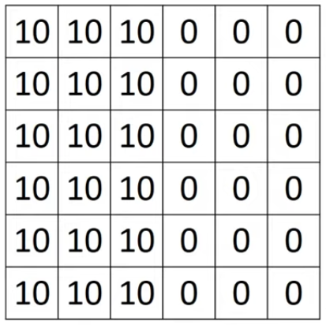
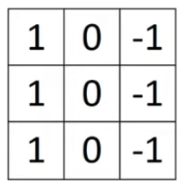
Edge detection
=
*

Slide 37
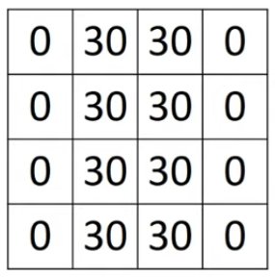
Edge detection
=
*

Slide 38
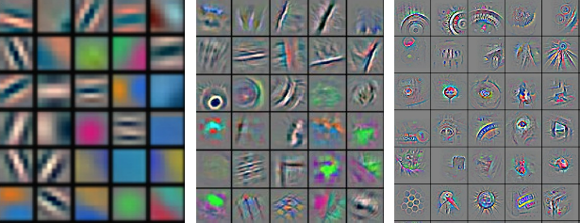
Feature extraction

Slide 39
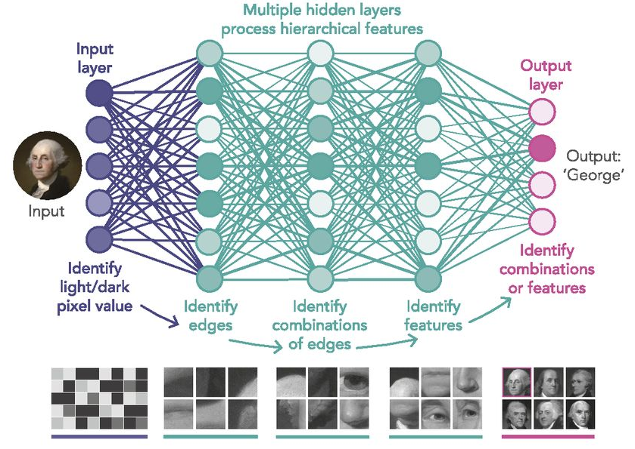
Feature extraction

Slide 40
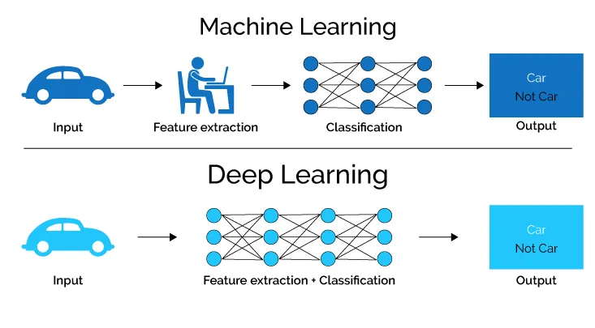
Feature extraction

Slide 41
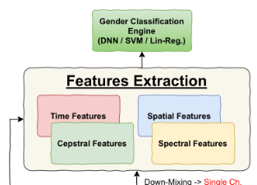
Why do we still care about Features extraction?
Sparse training set
Tuning capabilities
Debug & Manual intervention
Focus on important features
Simplifying training / Decrease learnable params
Notes:
Show gender classification example
What about images?!

Slide 42
Why do we still care about Features extraction?
Sparse training set
Tuning capabilities
Debug & Manual intervention
Focus on important features
Simplifying training / Decrease learnable params
Next big thing: Data Fusion

Slide 43
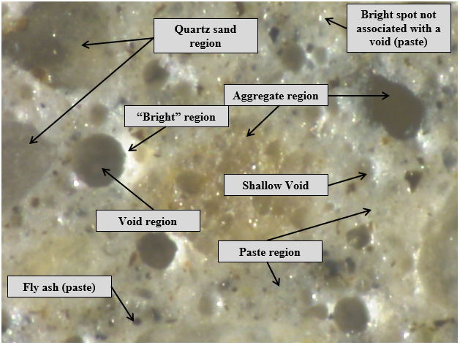
Data Fusion (By Example)
Voids are dark
Voids tend to be circular in shape
Paste is gray
Aggregate has various colors,
but can also be dark
Void edges illuminated by grazing
incidence light
regions are always to the
immediate right of the void

Slide 44
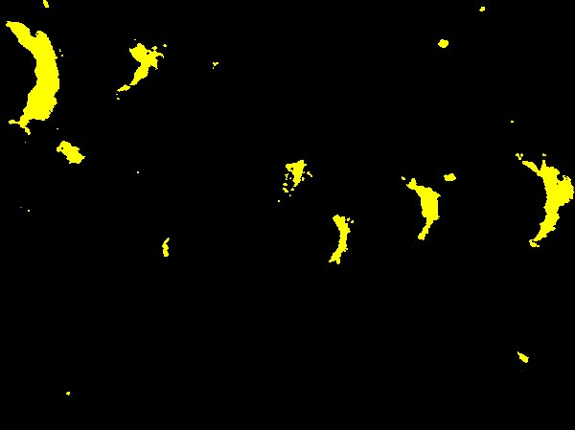
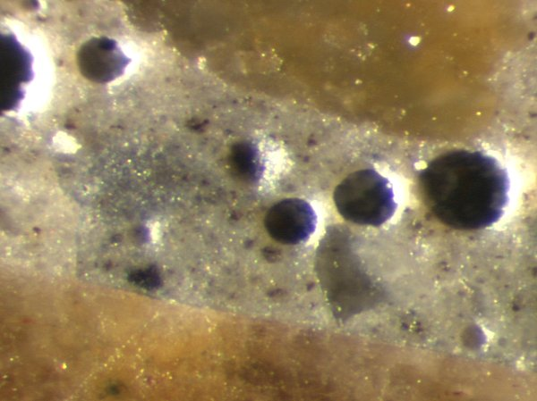
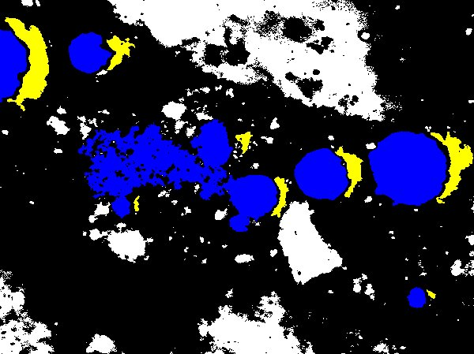
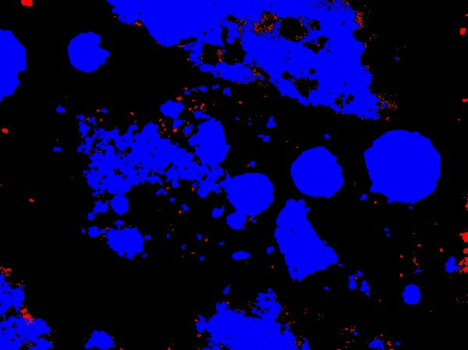
Data Fusion (By Example)
Void shapes
Component colors
Unique intensity structure of void-illuminated regions

Slide 45
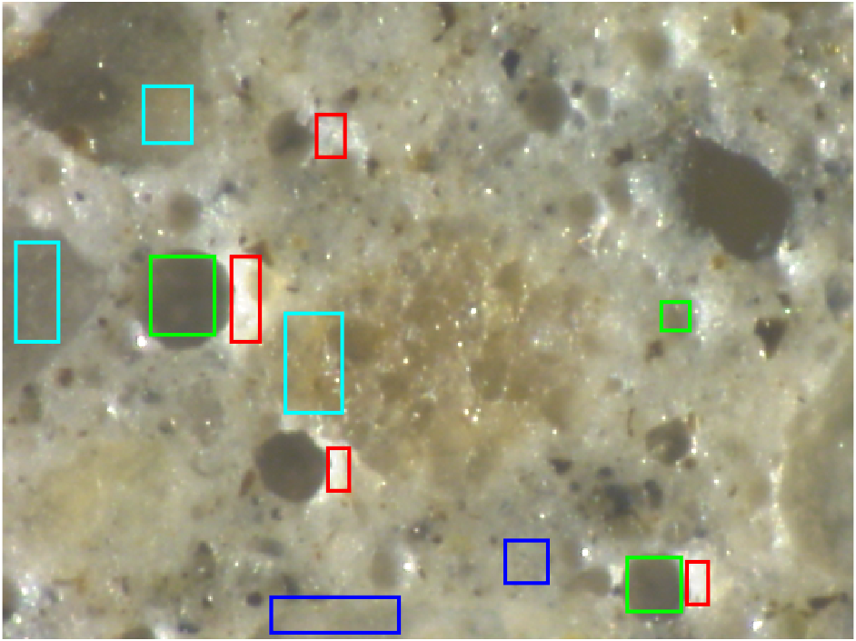
Data Fusion (By Example) - Augmentation
Green – Void areas (including shallow void)
Red – Bright areas
Blue – Aggregate areas
Cyan – Quartz sand areas

Slide 46
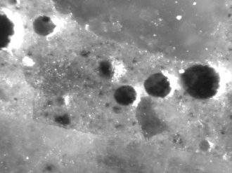
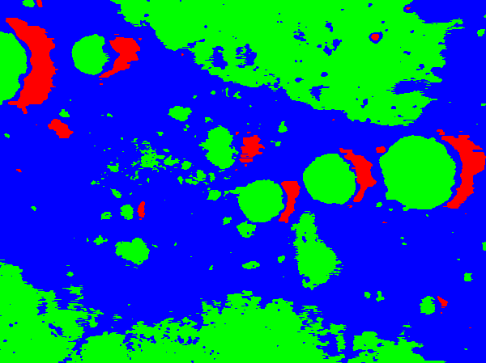
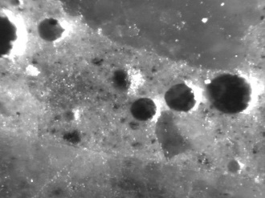
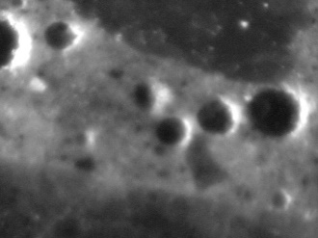
Data Fusion (By Example) - Augmented NN
Red
Green
Neural Network
Color Classified

Slide 47
Data Fusion (By Example) - Augmentation

Slide 48
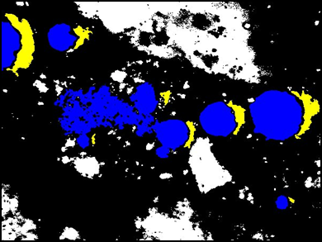
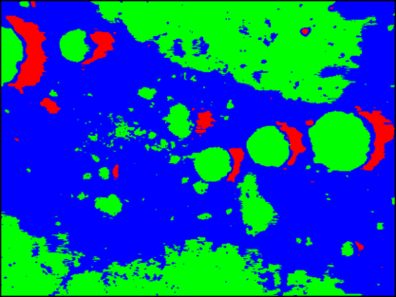
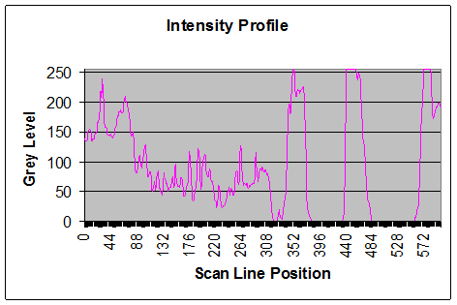
Data Fusion (By Example)
Modality 1
3 of 4 targets detected
4 false alarms
Decision Variable
(feature)
Fusion: one step upstream
Threshold
4 of 4 targets detected
1 false alarm
4 of 4 targets detected
1 false alarm
Combined Decision Variable (feature)
Fusion Process
Modality 2
4 of 4 targets detected
5 false alarms
Decision Variable
(feature)
Threshold

Slide 49
Feature extraction – What a feature is?
Visual
Non-Visual
Semi-Visual
Custom

Slide 50
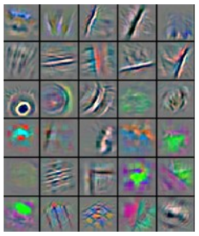
Feature extraction – What a feature is?
Visual
Non-Visual
Semi-Visual
Custom

Slide 51
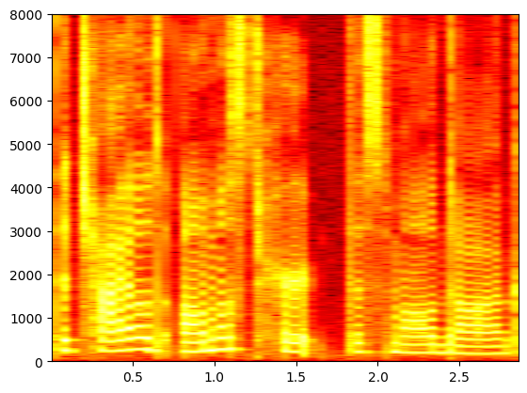
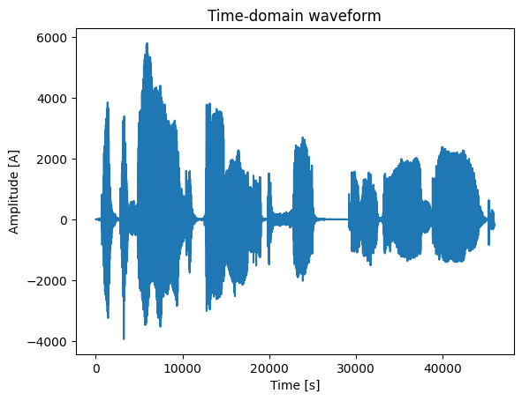
Feature extraction – What a feature is?
Visual
Non-Visual
Semi-Visual
Custom
Pretty? huh….?
But has physical meaning

Slide 52






Feature extraction – What a feature is?
Visual
Non-Visual
Semi-Visual
Custom

Slide 53
Feature extraction – What a feature is?
Visual
Non-Visual
Semi-Visual
Custom

Slide 54


Feature extraction – What a feature is?
Visual
Non-Visual
Semi-Visual
Custom

Slide 55
DNN Building Block
Activation
Normalization (Batch)
Pooling

Slide 56

Activation Function
Non-linear
Cont. or Non-Continuous
Cont. or Non-Cont. derivate

Slide 57
Brief introduction to training
Supervised Learning
Unsupervised Learning
Genetic algorithms (reinforced learning)

Slide 58

Brief introduction to training
Supervised Learning
Unsupervised Learning
Genetic algorithms (reinforced learning)

Slide 59

Brief introduction to training
Supervised Learning
Unsupervised Learning
Genetic algorithms (reinforced learning)
Sequential clustering
BSAS
MBSAS
TTSAS
Clustering based on cost function optimization
Hard clustering
K-Means clustering
GMDAS
Fuzzy clustering

Slide 60
Brief introduction to training
Supervised Learning
Unsupervised Learning
Genetic algorithms (reinforced learning)

Slide 61

Supervised Learning

Slide 62
Learning algorithm
Back-propagation
Gradient descent

Slide 63

Learning algorithm
Back-propagation
Gradient descent

Slide 64

Back-propagation

Slide 65
Learning algorithm
Back-propagation
Gradient descent

Slide 66
Loss function(s)
L1
L2
Huber

Slide 67

Learning algorithm
Back-propagation
Gradient descent

Slide 68

Learning algorithm
Back-propagation
Gradient descent (learning rate)
Step_size = slope x learning_rate

Slide 69
Demo Time

Slide 70

Occlusion Sensitivity
Dog

Slide 71


Occlusion Sensitivity
?

Slide 72
Occlusion Sensitivity - Demo Time

Slide 73
Learning algorithm (set)
Mini-batch
Epoch
Cost-function

Slide 74


Pooling
Smoothing feature map
Avg pooling
Max pooling

Slide 75



ResNet50

Slide 76
ResNet50 - Demo

Slide 77

© 2015 Microsoft Corporation. All rights reserved. Microsoft, Windows, and other product names are or may be registered trademarks and/or trademarks in the U.S. and/or other countries.
The information herein is for informational purposes only and represents the current view of Microsoft Corporation as of the date of this presentation. Because Microsoft must respond to changing market conditions, it should not be interpreted to be a commitment on the part of Microsoft, and Microsoft cannot guarantee the accuracy of any information provided after the date of this presentation. MICROSOFT MAKES NO WARRANTIES, EXPRESS, IMPLIED OR STATUTORY, AS TO THE INFORMATION IN THIS PRESENTATION.

